Slide 1
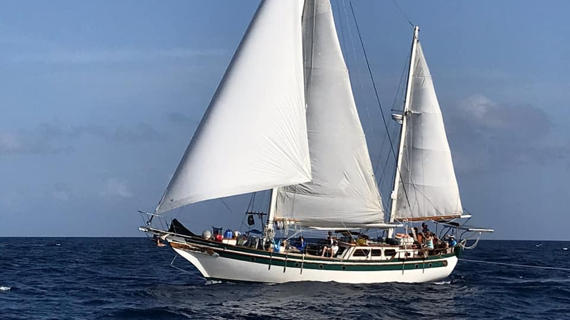
Sea Base St. Thomas Sailing adventure
2024 Programs Information Session
Capt. Alex Duff, Program Coordinator, Sea Base St. Thomas
Seabase.St.Thomas@gmail.com
(305) 998-9315

Slide 2
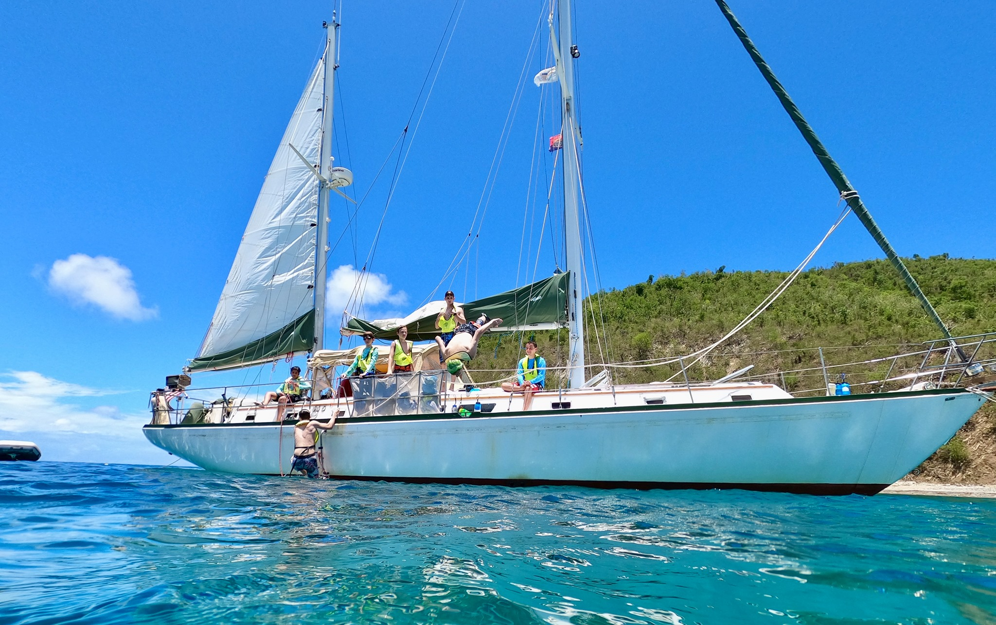
Sea Base St. thomas
Crews of 6-8 Sea Base High Adventure Sailing (6 days/5 nights)
Crew Size: 6-8
TA 061024 A
Crews of 10-12 Sea Base High Adventure Sailing (6 days/5 nights)
Crew Size: 10-12
TS 071024 A

Slide 3
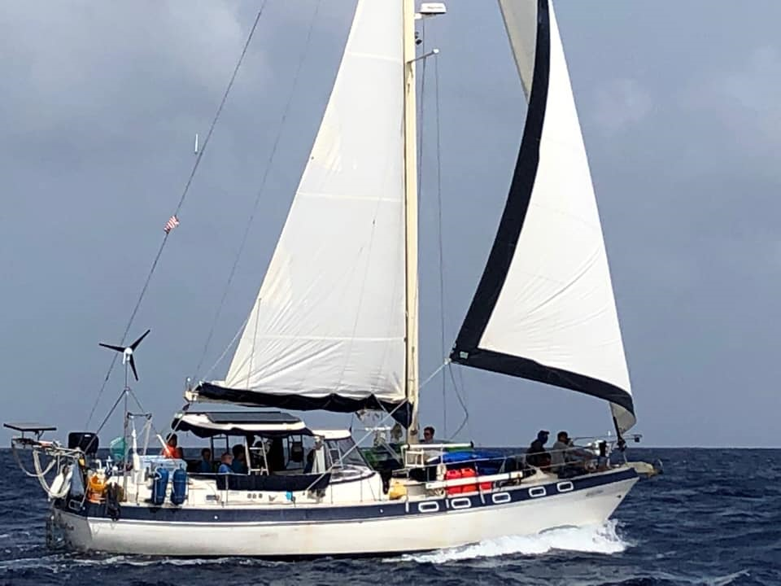
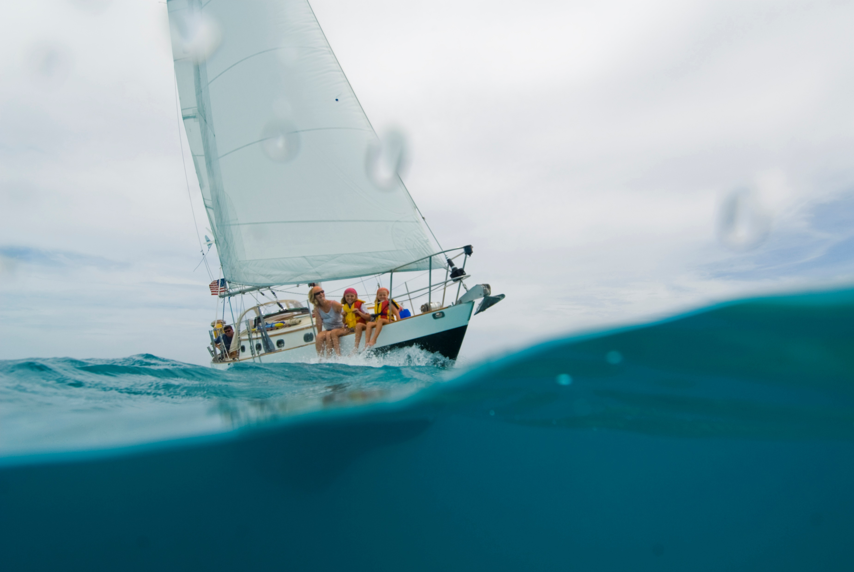
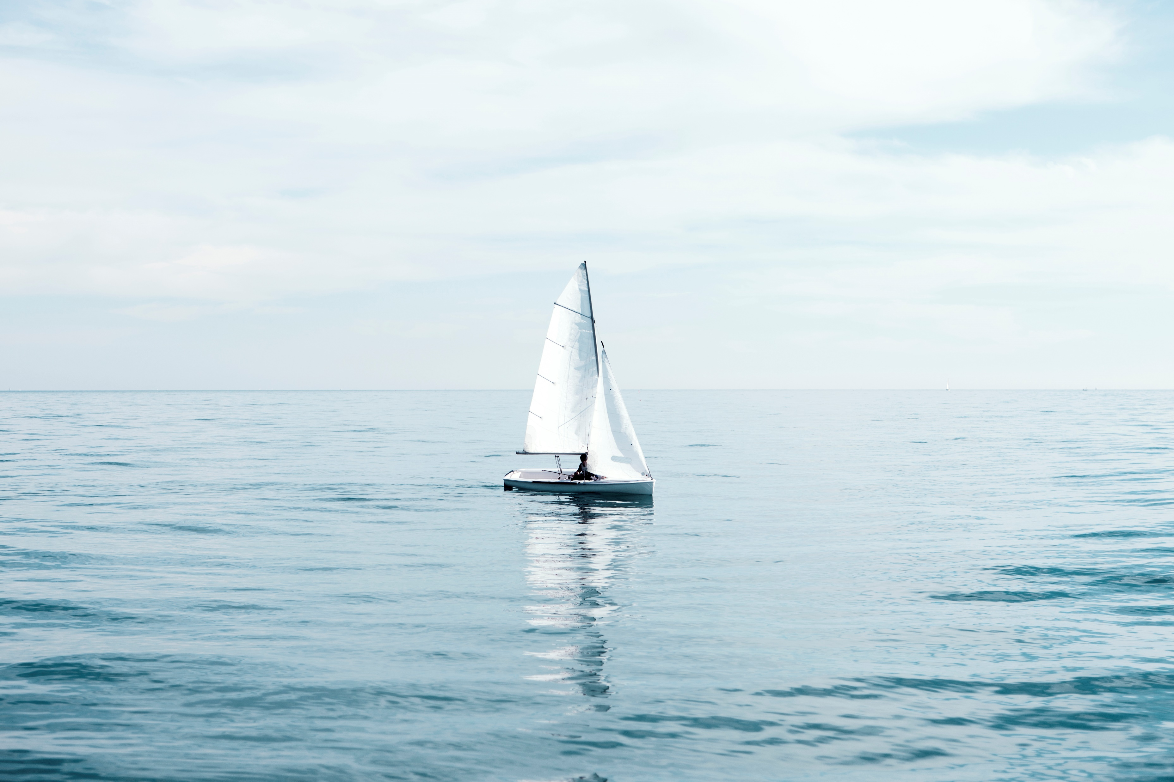
Eligibility
General Eligibility
Adult Leader Eligibility
Registered Member of BSA
BSA Swim Classification-Swimmer
13 years of age
Medically Approved to Participate
(BSA AHMR)
Registered Member of BSA
BSA Swim Classification-Swimmer
Medically Approved to Participate
Completed Training Certificates
YPT, Safe Swim Defense, Safety Afloat, Haz. Weather, and one adult must have WFA and one adult must be CPR/AED certified.
21 years of age or older

Slide 4

Paperwork
At a Glance-By Crew
At a Glance-For Adults
Crew Roster (90 days prior to arrival)
Pre-Event Medical Screening
Should be filled out just prior to departing for Sea Base.
Vessel Liability Waiver (first 2 spots left blank)
Have parents sign for youth prior to departing
Unit Swim Classification
BSA AHMR (BSA Medical)
Must be 2019 version
Good for one year
Copies of Insurance Cards (Front & Back)
At least one adult leader
CPR/AED
Wilderness First Aid or greater certification (course must have in-person section)
Each adult leader
Youth Protection Certificate
Safe Swim Defense Certificate
Safety Afloat Certificate
Hazardous Weather Certificate

Slide 5
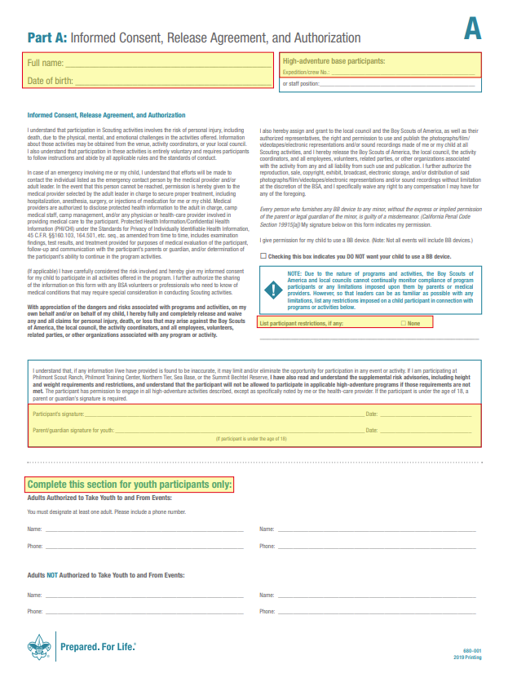
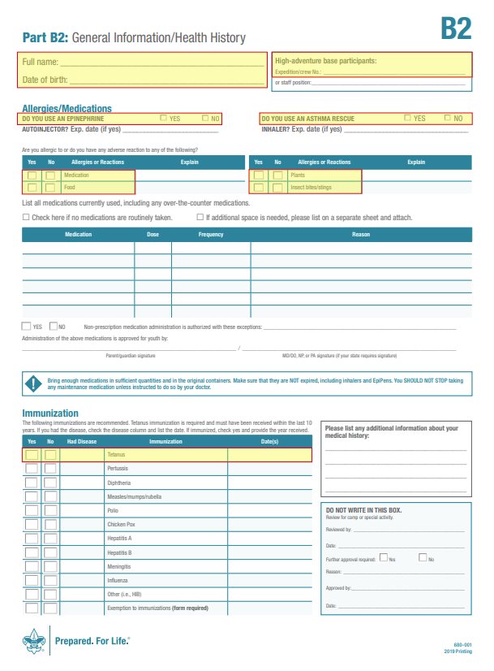
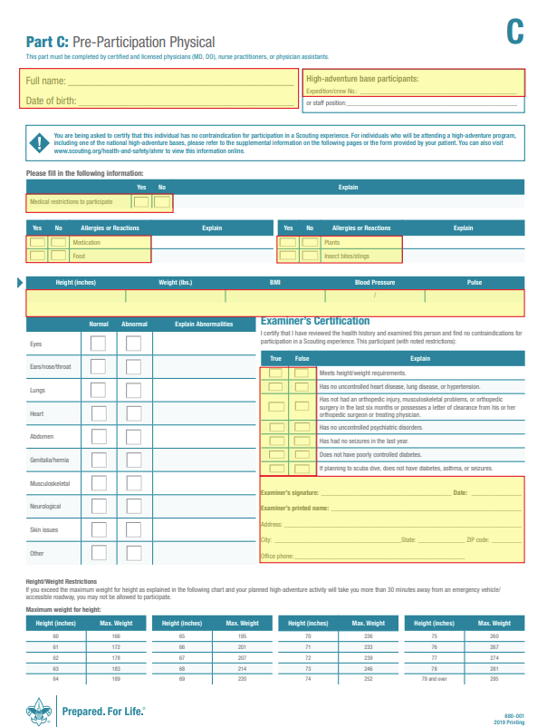
Common mistakes on the medical

Slide 6
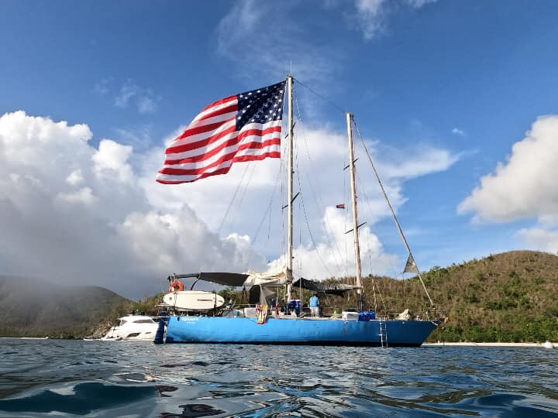
SEA BASE ST THOMAS
6 day/5 night adventure (For example - Arrive Sunday, depart Friday)
Arrival day: Check in at 1 pm with Sea Base Staff at Saphire Marina, ST Thomas.
Check-in: Meet Sea Base Staff at Saphire Marina Parking lot, receive vessel assignment, Paperwork check, crew photo, safety orientation, vessel departs.
You will spend the first afternoon learning the vessel, the rules, do a swim review, and then dive in for some snorkeling.
Days 2-5: Sailing, hiking, snorkeling, and exploring the US Virgin Islands by sailboat, potentially circumnavigating the island of St John and visiting many other islands along the way.
Departure day: Boat will return to dock between 8:30-9:30 am. Crew will clean vessel, have dock showers, and then check out at 11:45

Slide 7
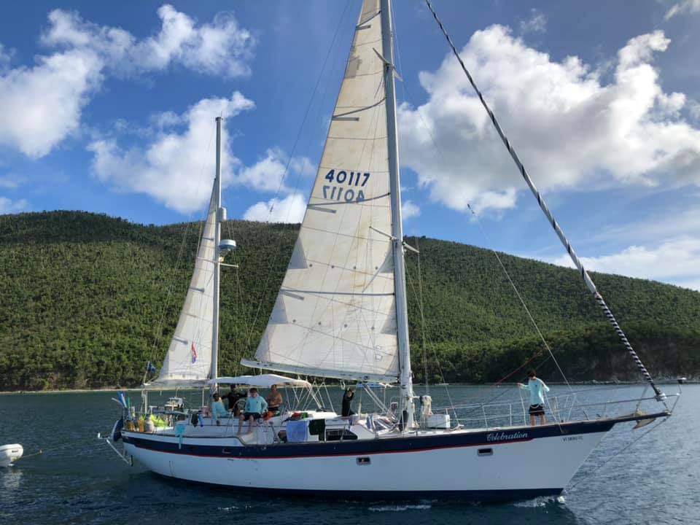
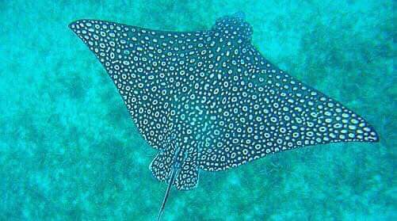
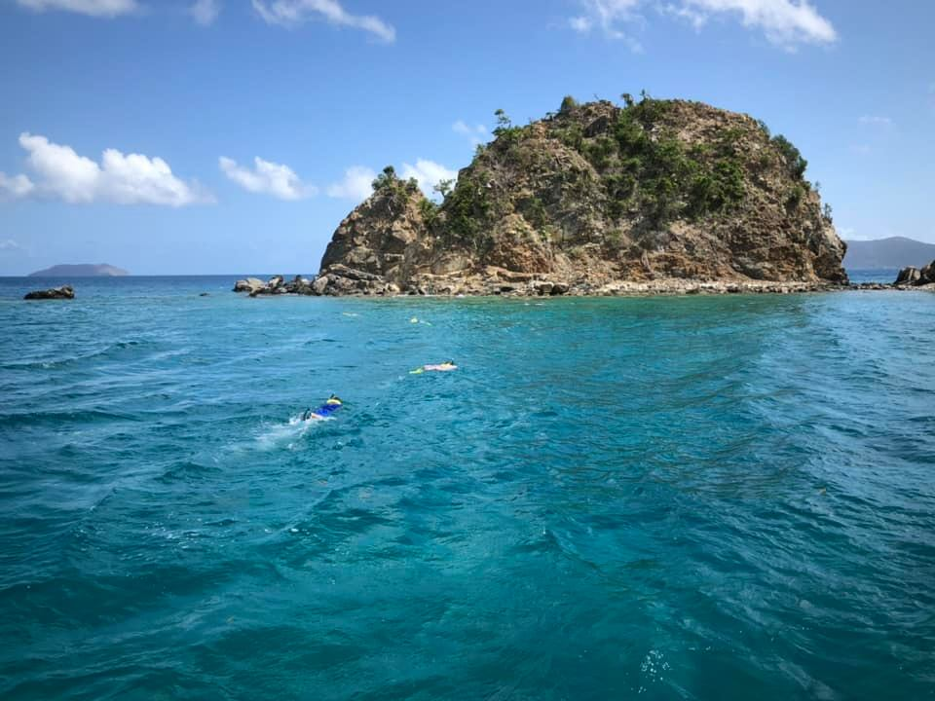

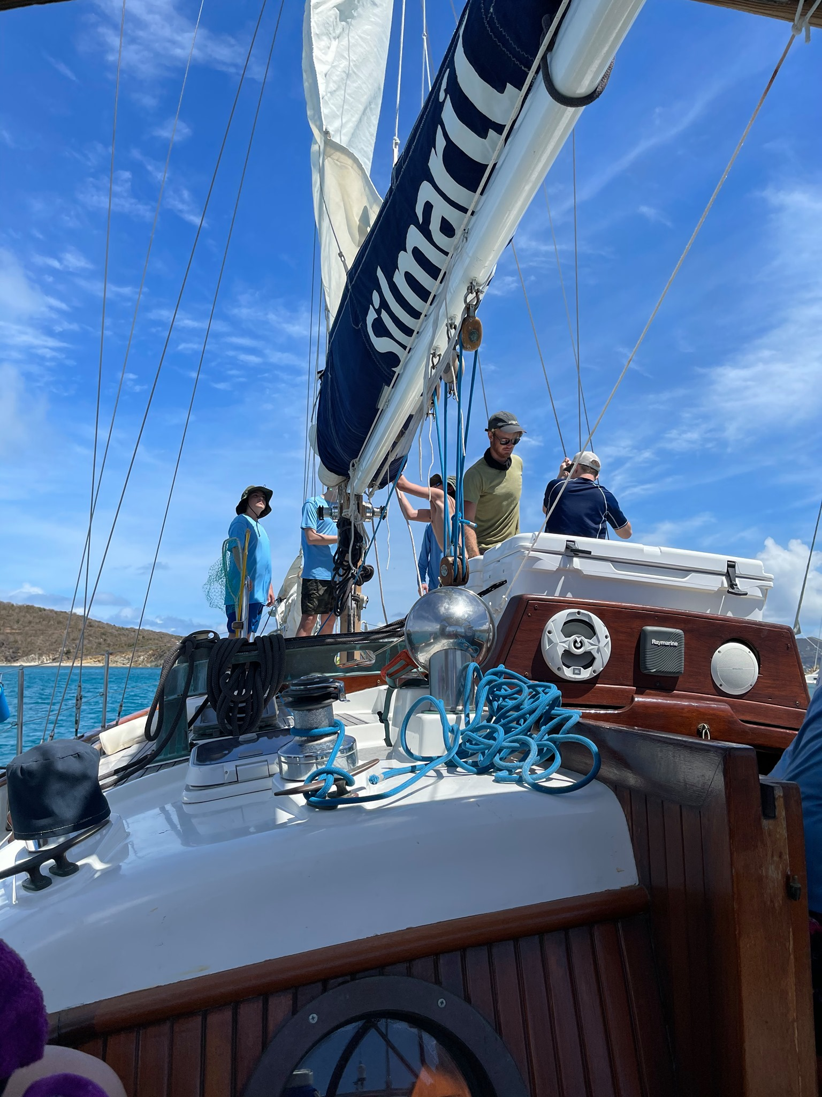
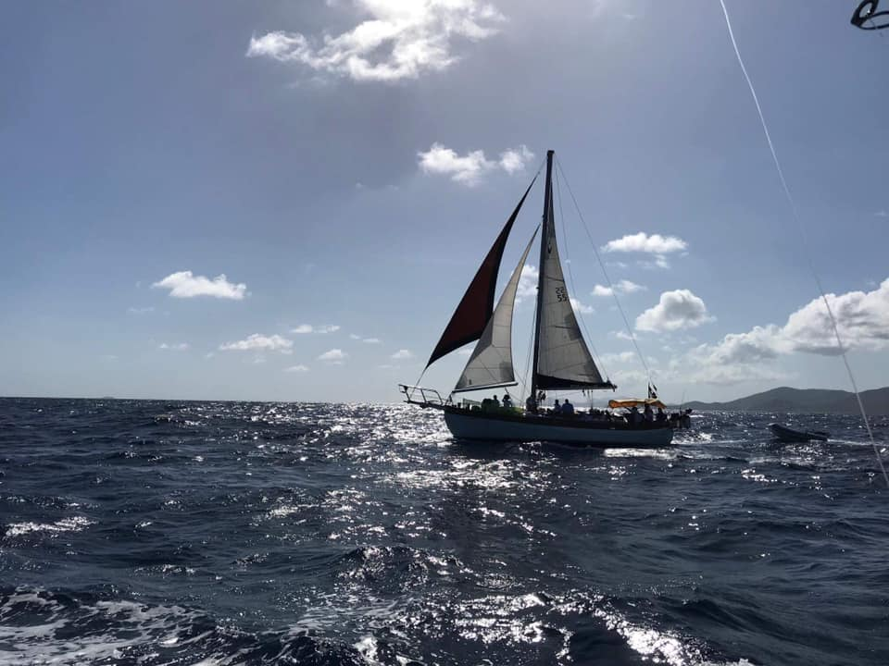
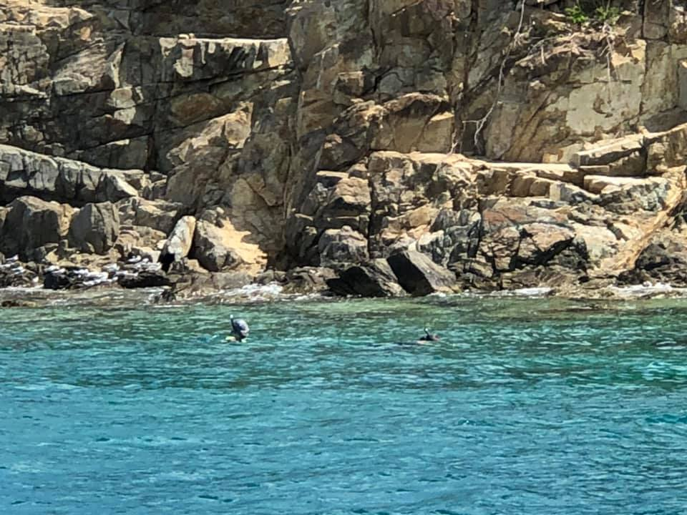
Adventure awaits in the U.S. Virgin Islands.

Slide 8
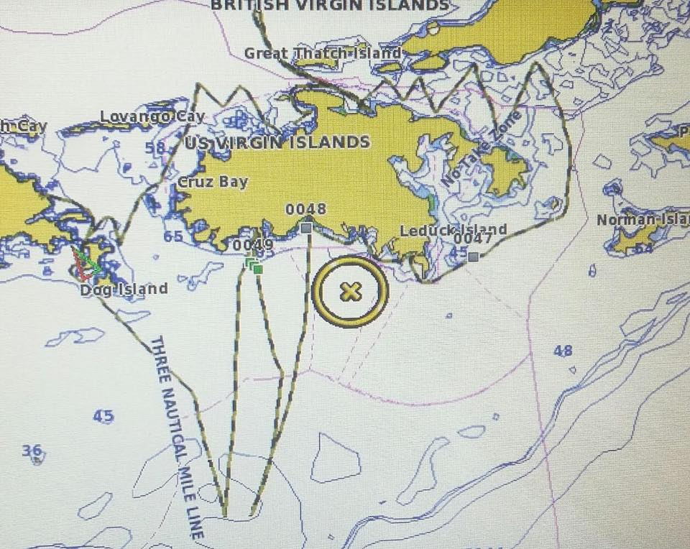


What’s the Route?
Every voyage is a little different depending on the weather and preferences of the crew.
Your crew will plan a route through the US Virgin Islands and have opportunities every day to hike, snorkel, and sail in different locations. The crew will be simultaneously circumnavigating the island of St John, exploring the National park, and other Virgin Islands along the way.

Slide 9
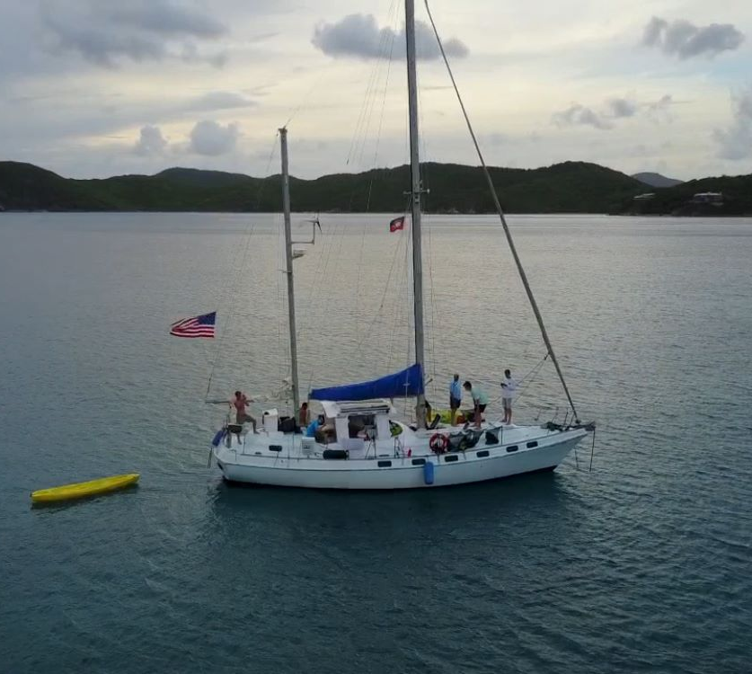
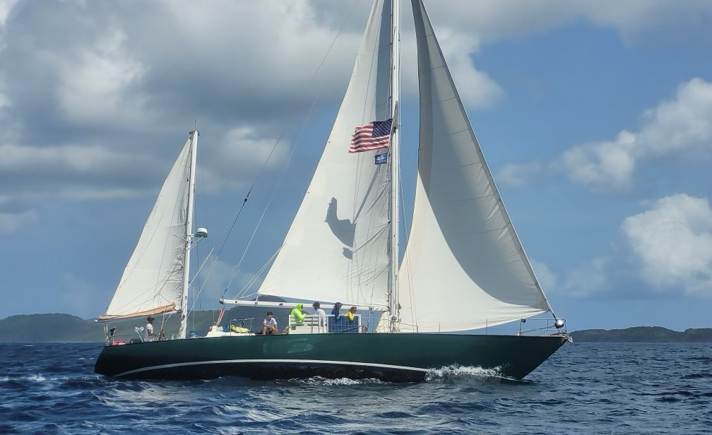
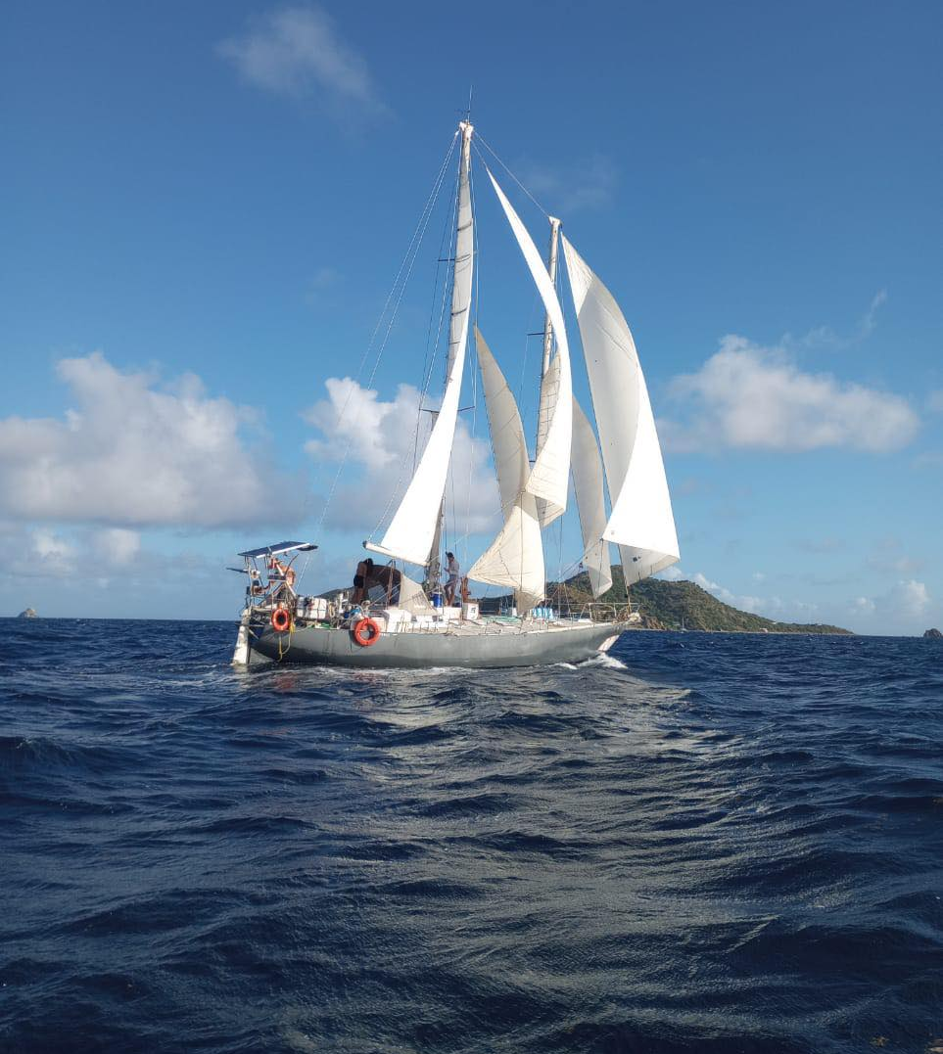
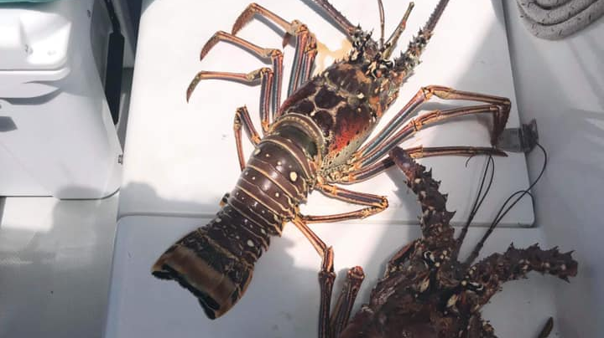





What Can I do to Prepare for Sea Base?
Practice swimming at your local pool.
Test and practice with your personal snorkel and mask. (You can practice at a pool before arrival to Sea Base to gain confidence).
Familiarize yourselves with the current Participant Guide.

Slide 10
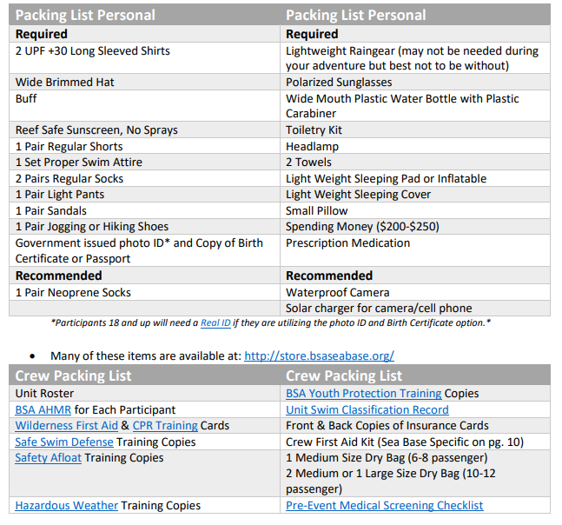
Prep and Packing list →

Slide 11
Prep and packing faq
How should I pack all my stuff?
Sea Base St Thomas has no on-site storage so all personal gear must fit into an approximately 20”-24” duffel style bag. Crews of 6-8 may bring one large crew duffle, crews of 10-12 may bring two crew duffels.
What mask and snorkel should I bring?
You can purchase a mask and snorkel from the Sea Base Ship Store or go to your local dive shop or even Walmart. Anything that you are comfortable in will work. *Full facemasks are NOT permitted*
Should I bring fishing gear?
Sea Base will provide all fishing gear you will need.
Should I bring a water bottle?
You should bring a Nalgene-style, reusable water bottle. Please do not bring metal water bottles.
What kind of shoes should I bring?
Any type of strap on sandal or tennis shoe is recommended for the hikes in the St John National park. Flip Flops are NOT recommended for hiking.

Slide 12




General faq
Will there be coffee?
There is coffee aboard.
Will I be able to charge my phone?
That is not guaranteed. The suggestion is to keep your phone in airplane mode and only use it for pictures. Bring solar chargers or battery backups.
Will there be power on the boat for me plug in my CPAP machine?
That is not guaranteed. The suggestion is to bring battery backups for your CPAP machine.
What are sleeping arrangements like?
Most crews choose to sleep on deck. As such, a backpacking style sleeping pad and light blanket or sheet is suggested.
Don’t hesitate to contact the Sea Base St Thomas Staff about any questions your crew may have.

Slide 13




TRAVEL faq
Can we check in to Sea Base after 1 pm?
Check in Between 1-5pm will allow your crew to set sail that day. Crews that check in after 5 pm will spend their first night aboard in the marina.
When should we arrive at the St Thomas airport to fly home?
The Cyril E. King Airport can be very busy with departing visitors resulting in long lines. You should arrive at the airport 2.5-3 hours before your flight.
What is required for travel to and from the US Virgin Islands?
For each traveler to clear Customs, a government ID and COPY of traveler’s birth certificate. Or a US PASSPORT or PASSPORT CARD.
Why do we have to clear Customs to re-enter the US?
While The US Virgin Islands is a US territory, it is DUTY FREE so all travelers must clear customs to re-enter the continental US.
As a United States Territory, travel to the U.S. Virgin Islands does not require a passport for U.S. citizens arriving from Puerto Rico or the U.S. mainland.****

Slide 14
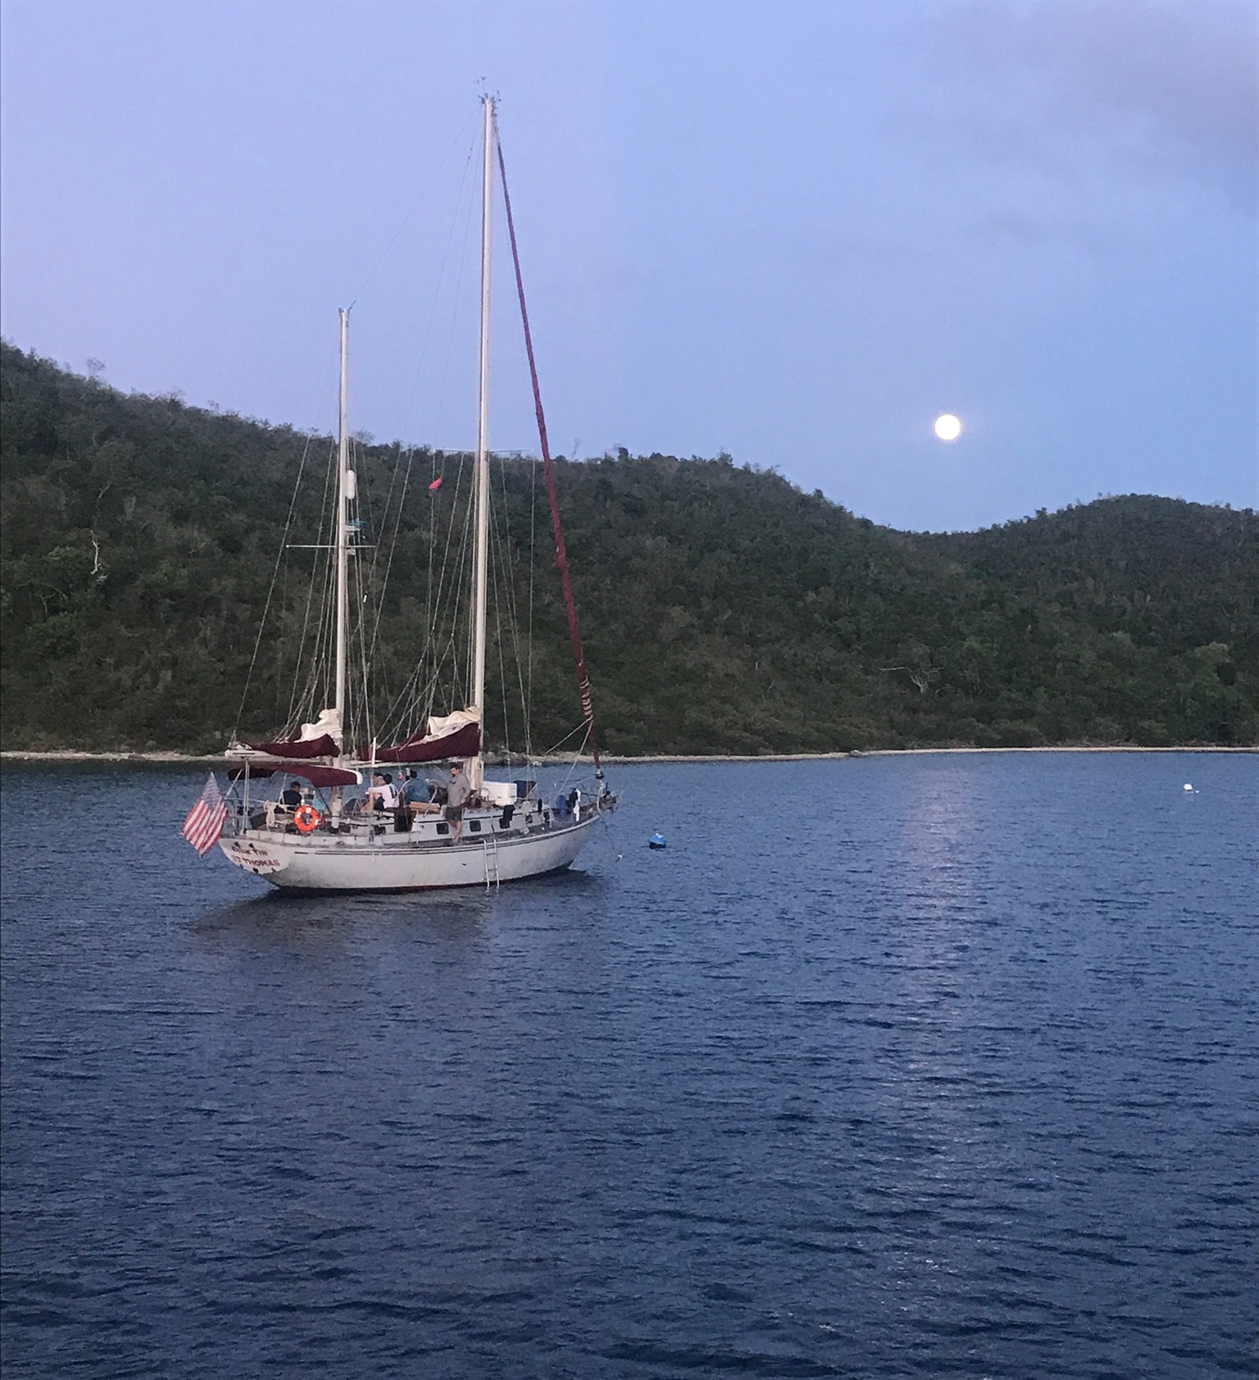
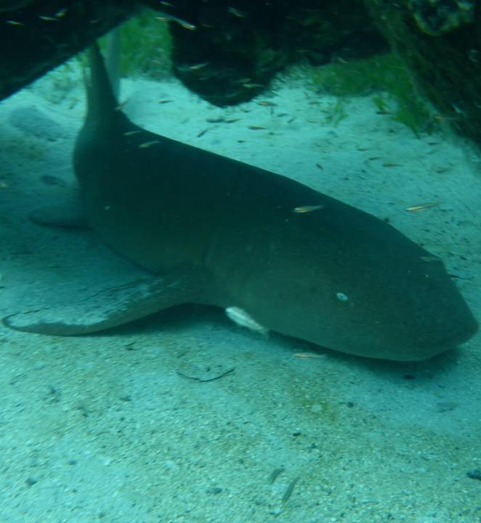
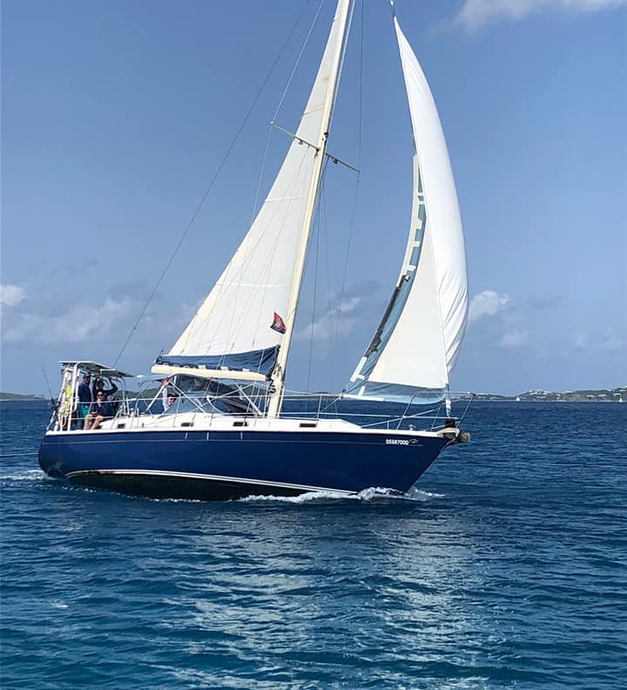

Set sail this summer!
Seabase.St.Thomas@gmail.com
(305) 998-9315

