Slide 1
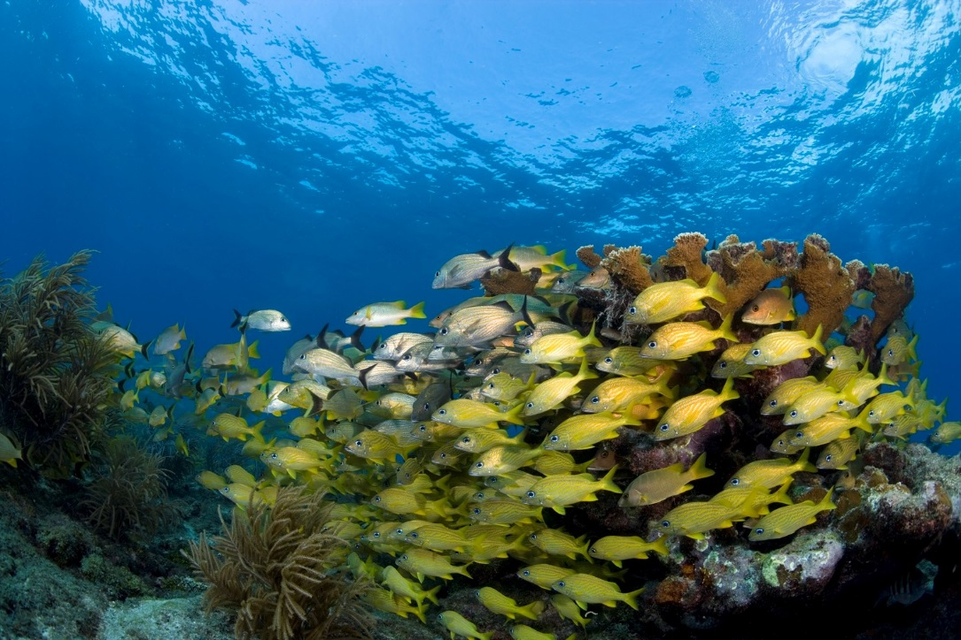

National High Adventure Sea Base
Boy Scouts of America
Brinton Environmental Center Adventures
Keys Adventure
Out Island Adventure
Fishing Adventure
Marine Eco Expedition

Slide 2
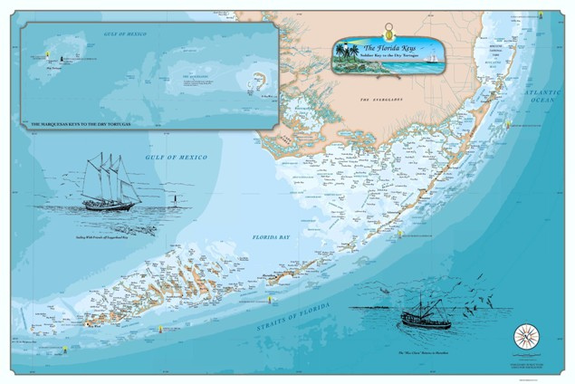
The Florida Keys
Brinton Environmental Center
Mile Marker 23.8
Florida Sea Base
Mile Marker 73.8
Your adventure will take place at the Brinton Environmental Center
23800 Overseas Highway, Summerland Key, FL 33042

Slide 3

Eligibility Requirements
Crew Rosters completed 90 days prior to arrival
All participants must be 12 years of age or older for Fishing Adventure, Keys Adventure and Marine Eco Expedition
All participants must be 13 years of age or older for the Out Island Adventure
Registered member of the BSA
All adult leaders must complete the following adult leader trainings: BSA Safe Swim Defense, BSA Safety Afloat, BSA Hazardous Weather, BSA Youth Protection. Please provide copies of certificates upon arrival
At least one adult leader per crew must have Wilderness First Aid and CPR/AED certifications. Please provide copies of certifications upon arrival
All participants must pass the BSA Swim Test prior to arrival as a Swimmer, evidenced by the Unit Swim Classification Record. All participants must complete the Sea Base Swim Review upon arrival. Non-swimmers will be sent home at their own expense.
Medically Approved for Participation, evidenced by the BSA Annual Health and Medical Record & meets Sea Base Risk Advisory Medical Requirements
Pre-Event Medical Screening Checklist per crew
No participant can exceed 295lbs as evidenced by the medical form. No exceptions will be made. Participants exceeding 295lbs will be sent home at their own expense.

Slide 4

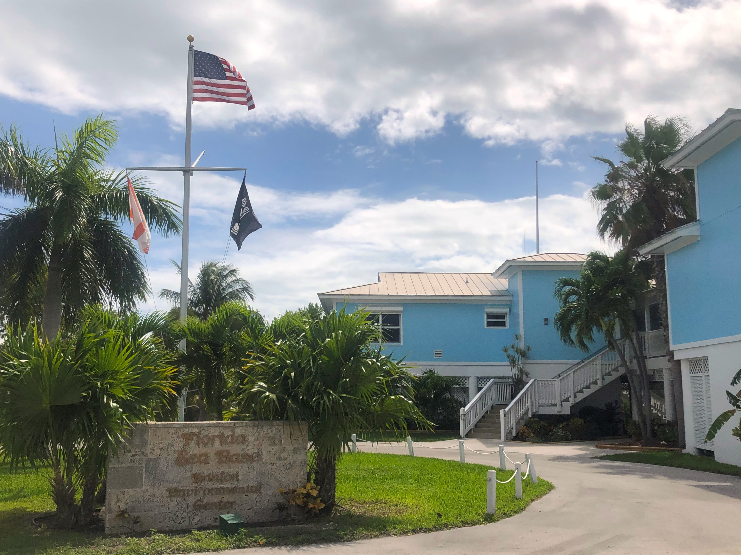
Arrival & Registration
Arrival Time is between 1 PM and 3 PM
Check in and review documents
Meet your Mate
Check into Dorms
Issue Snorkel Gear
BSA Swim Review
Snorkel Lesson
Opening Shindig

Slide 5
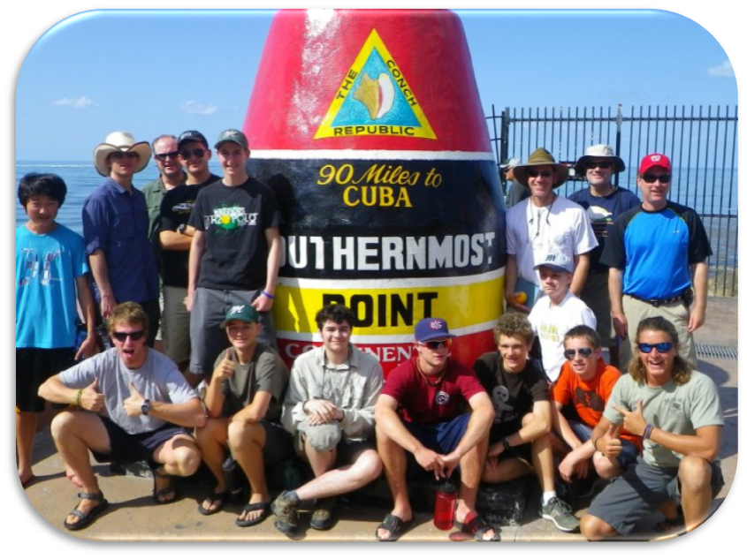
Required Paperwork
Sea Base Check-In Documents
Crew Roster
BSA Annual Health and Medical Records
Unit Swim Classification Record
Adult Leader Training Certificates
WFA & CPR/AED Training Certificate(s)
Pre-Event Medical Screening Checklist
All copies of forms should be placed in a folder or notebook and submitted upon arrival during check-in. Please refrain from using plastic sleeves to ensure a timely check-in process.

Slide 6
Keys Adventure Weekly Schedule
Keys Adventure Tentative Schedule
Day 1 | Day 2 | Day 3 or 6 | Day 4 | Day 5 | Day 3 or 6 | Day 7
Arrive 1-3 PM | Breakfast | Breakfast | Breakfast | Breakfast | Breakfast | Breakfast
Check In | Paddle Boarding | Snorkeling | Fishing | Kayak through Mangrove Lagoon | Sailing | Clean Dorm Room
Base Tour | Lunch at Fort Zachary Taylor in Key West | Lunch on Snorkel Boat | Lunch on Fishing Boat | Island Tour | Lunch on Sail Boat | Depart by 10 AM
Swim Review Snorkel Lesson | Free time to explore in Key West | Visit Bahia Honda State Park | Dropped off at Big Munson Island | SCENE Project | Conch Luau
Dinner on Base | Dinner in Key West & Sunset Festival | Dinner on Base | Dinner on Big Munson Island with fresh catch | Dinner on Base | Dinner at Conch Luau
Opening Program | Return to base 9 - 9:30pm | Bridge Fishing | Overnight on Big Munson | Night Snorkel | Closing Ceremony
Please note that program is dictated by weather, tides and the ability of the crew. Your activity plan can vary, sometimes widely, due to these factors.

Slide 7
Out Island Adventure Weekly Schedule
Out Island Adventure Tentative Schedule
Day 1 | Day 2 | Day 3 | Day 4 | Day 5 | Day 6 | Day 7
Arrive 1-3 PM | Breakfast | Breakfast | Breakfast | Breakfast | Breakfast | Breakfast
Check In | Gear & Food Shakedown | Kayak through Mangrove Lagoon | Fishing | Snorkeling | Clean campsite and pack up | Clean Dorm Room
Base Tour | Early Lunch | Lunch | Lunch on Boat | Lunch on Boat | Paddle to Brinton Center | Depart by 10 AM
Swim Review Snorkel Lesson | Paddle to Big Munson Island | Shark Fish | Dropped off at Big Munson Island | SCENE Project | Lunch at Base
Dinner on Base | Settle into Camp | Island Tour | Cook your Catch for Dinner | Dinner | Dinner & Conch Luau
Opening Program | Island Campfire | Dinner | Night Snorkel | Crab Race | Closing Ceremony
Please note that program is dictated by weather, tides and the ability of the crew. Your activity plan can vary, sometimes widely, due to these factors.

Slide 8
Fishing Adventure Weekly Schedule
Fishing Adventure Tentative Schedule
Day 1 | Day 2 | Day 3 | Day 4 | Day 5 | Day 6 | Day 7
Arrive 1-3 PM | Breakfast | Breakfast | Breakfast | Breakfast | Breakfast | Breakfast
Check In | Reef Fishing | Offshore Fishing | Back Country Fishing | Snorkeling | Shark Fishing | Clean Dorm Room
Base Tour | Lunch on Boat | Lunch on Boat | Lunch on Boat | Lunch on Boat | Lunch on Boat | Depart by 10 AM
Swim Review Snorkel Lesson | Clean Boat and Filet Catch | Clean Boat and Filet Catch | Clean Boat and Filet Catch | Explore Key West | Clean Boat and Filet Catch
Dinner on Base | Dinner | Dinner | Dinner | Dinner in Key West | Dinner & Conch Luau
Opening Program | Knots & Fishing Skills Lesson | Night Snorkel | Bridge Fishing Cook your Catch | Sunset Festival in Key West | Closing Ceremony
Please note that program is dictated by weather, tides and the ability of the crew. Your activity plan can vary, sometimes widely, due to these factors.

Slide 9
Marine Eco Expedition Weekly Schedule
Marine Eco Expedition Tentative Schedule
Day 1 | Day 2 | Day 3 | Day 4 or 5 | Day 4 or 5 | Day 6 | Day 7
Arrive 1-3 PM | Breakfast | Breakfast | Breakfast | Breakfast | Breakfast | Breakfast
Check In | All Day Snorkel aboard STEM 45’ Catamaran | Work in Land-based Coral Restoration Nursery | Island Day at Big Munson Island | Shark Fishing/Tagging | All day Snorkel aboard STEM 45’ Catamaran | Clean Dorm Room
Base Tour | Lunch on Boat | Picnic Lunch in Key West at Ft. Zachary Taylor/ visit coral restoration site | Picnic Lunch on Island | Lunch on Boat | Lunch on Boat | Depart by 10 AM
Swim Review Snorkel Lesson | Water Quality Sampling & Fish Surveys | Explore Key West | Island surveys and beach clean-up | Shark Fishing/Tagging | Coral Bleachwatch & Disease Surveys
Dinner on Base | Dinner Base | Dinner in Key West & Sunset Festival | Dinner Base | Dinner on Base | Conch Luau Dinner
Opening Program/ Fish ID Presentation | Presentations/Vessel Building | Return to base by 9:00 pm | Presentations/Vessel Building | Presentations/Vessel Building | Vessel Competition, Scout presentations
Please note that program is dictated by weather, tides and the ability of the crew. Your activity plan can vary, sometimes widely, due to these factors.

Slide 10
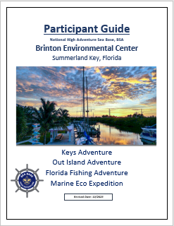
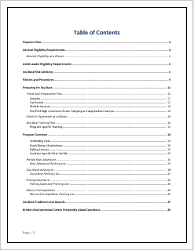
Packing Lists
Find packing lists for each Brinton Environmental Center adventure in your Participant Guide. You can find the participant guide on our website, www.bsaseabase.org, then at the top of your screen click “Scouts”, then “Resources”, then “Participant Guides”, then click the image like the one shown here.
Use the Table of Contents in your Participant Guide to help find the content you need by clicking on the needed section. After clicking on the title of the needed section, it will jump to that page.
Packing Lists for each adventure can be found on the following pages of your Participant Guide:
Keys Adventure: page 18
Out Island Adventure: page 21
Fishing Adventure: page 23
Marine Eco Expedition: page 26
The Brinton Center Participant Guide is your best resource for preparing for your adventure!

Slide 11
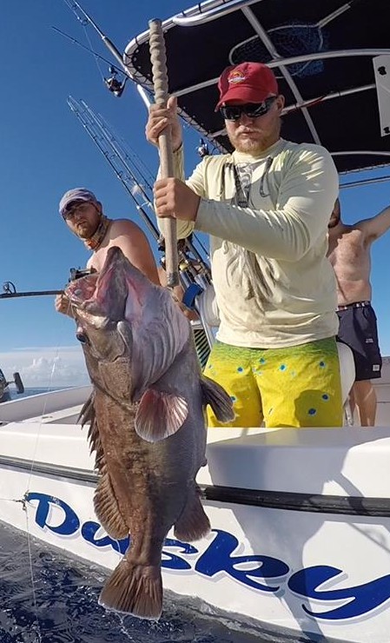
Fishing License
Fishing Licenses are needed for all participants ages 16 years of age and older. Saltwater licenses can be purchased at gooutdoorsflorida.com
Sea Base does not sell fishing licenses.
Please defer to page 15 of your Brinton Center Participant Guide to find out which license is best for you based on your chosen adventure and attending season.
We do not participate in Lobster Mini Season the last Wednesday/Thursday of July.

Slide 12
Program Specific Training
Sea Base Adventures are aquatics-based and require all participants, youth and adult alike, to be fit, competent swimmers. It is recommended that your unit, in consultation with physician and local council BSA Aquatics Director or a qualified aquatic professional, develops a crew training regimen. This regimen should include frequent pool training sessions, basic snorkeling instruction, paddle craft sessions, upper-body strength training and the BSA Swim Test, which is a requirement.
Become strong, competent swimmers (monthly swimming sessions are recommended).
Snorkel. Practice clearing a mask and snorkel. Practice equalizing the ears.
Practice fishing knots. Ex: Palomar Knot, Uni Knot, Unit-to-Uni Knot
Become proficient with nautical map and compass navigation.
Seek local Instruction regarding the use of VHF marine radios, safety flares, man overboard procedures and drill potential emergency situations.
Become proficient with paddle crafts (kayaking stand up paddleboard and/or canoe)
Practice gaining upper-body strength to lift oneself onto a dock/kayak/paddleboard/canoe.
Adult leaders plan an important role in ensuring safety aboard and in the water. Adults must understand BSA Safe Swim Defense and Safety Afloat Guidelines and be prepared to assist in emergency situations.
Watch: Reef Etiquette Video produced by NOAA.

Slide 13
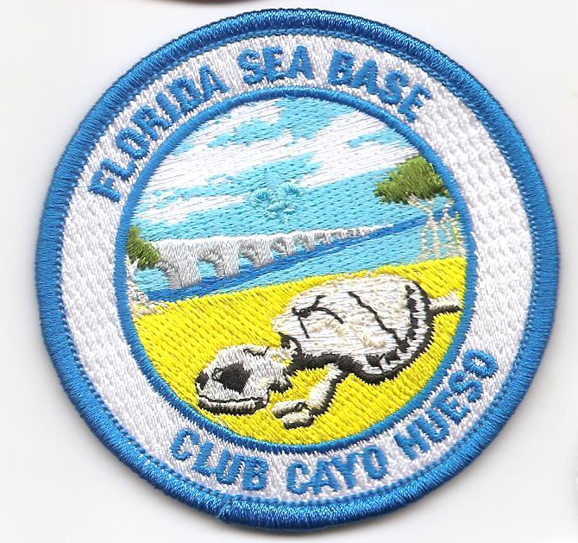
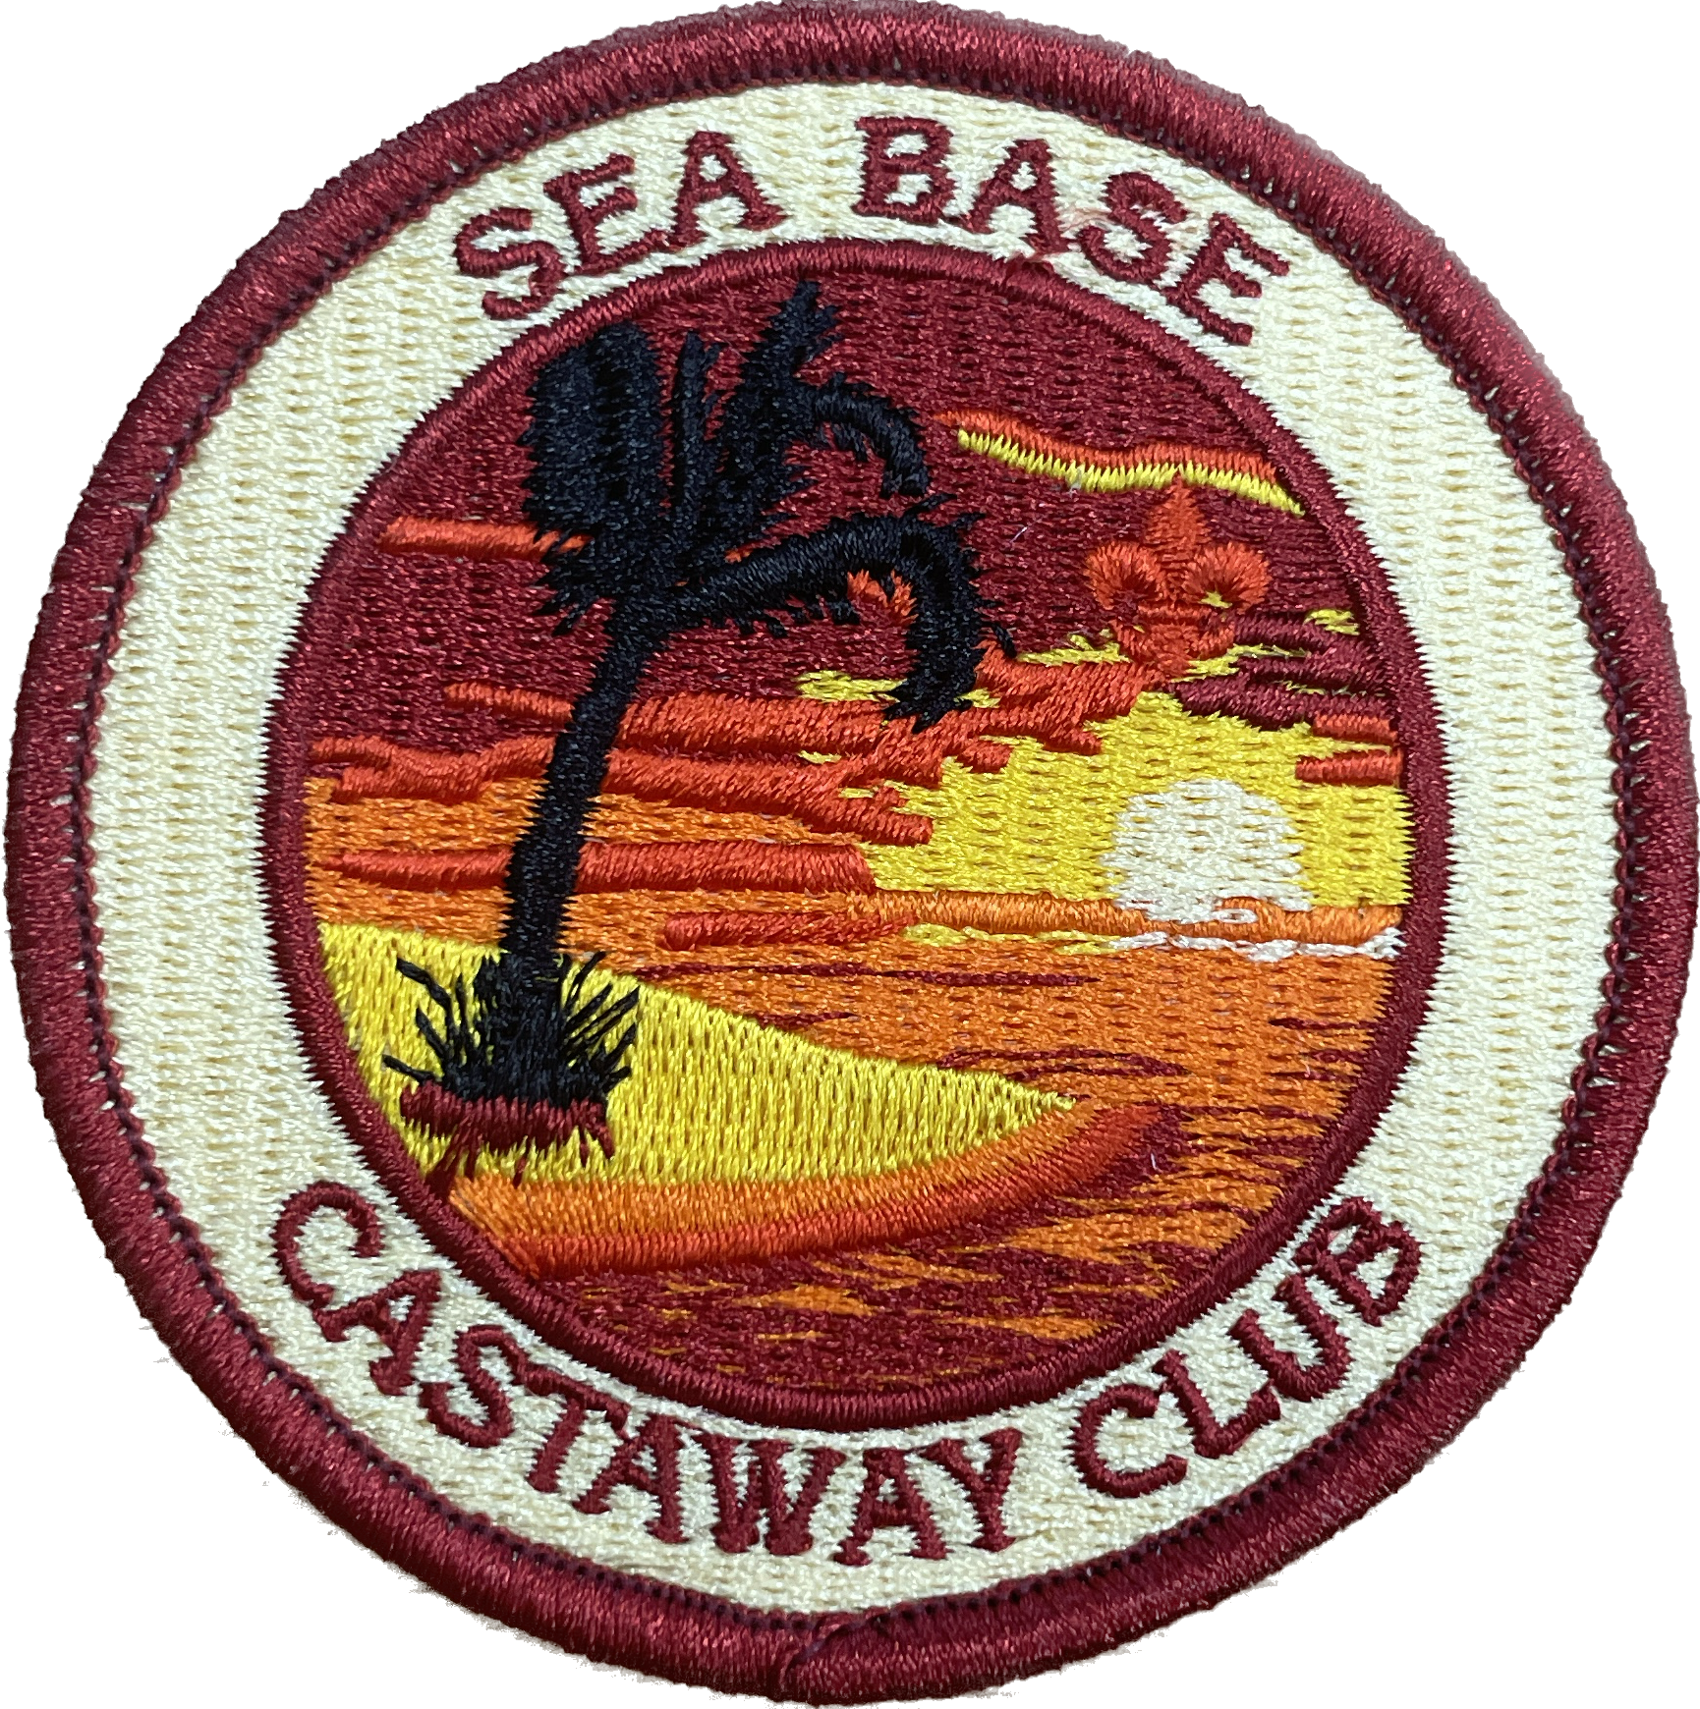
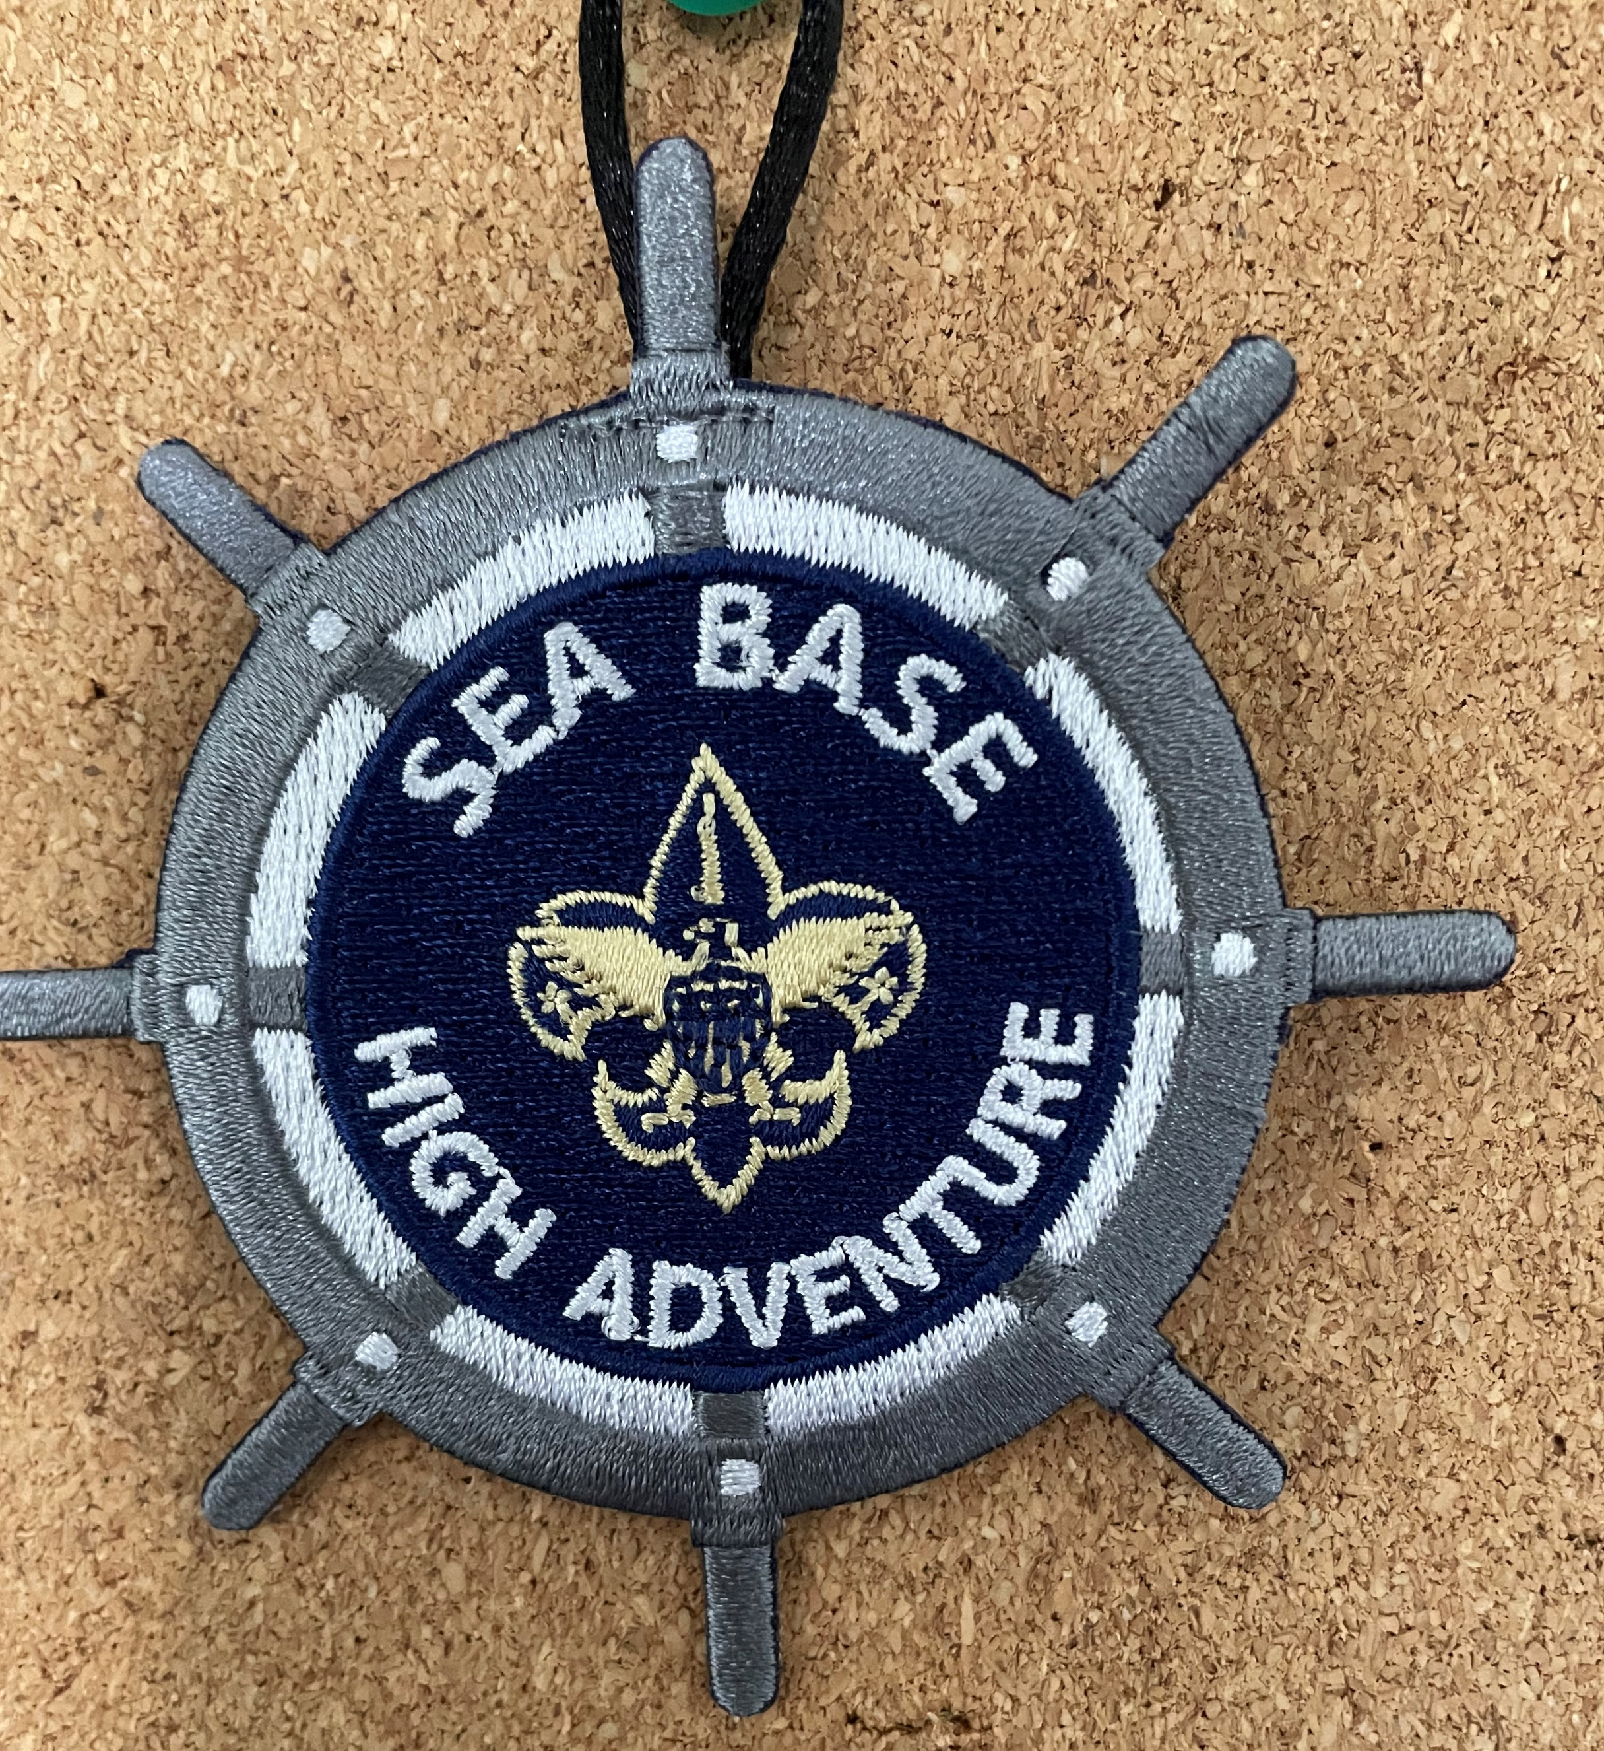
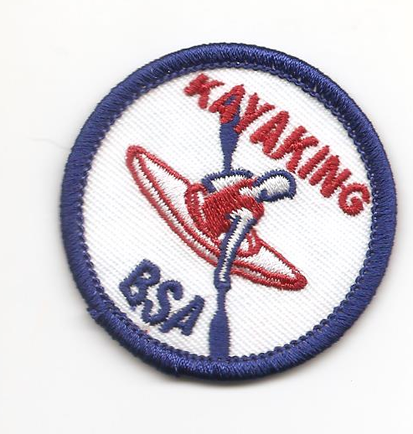
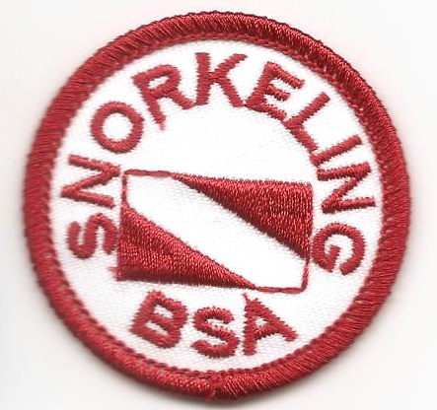
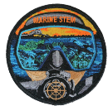

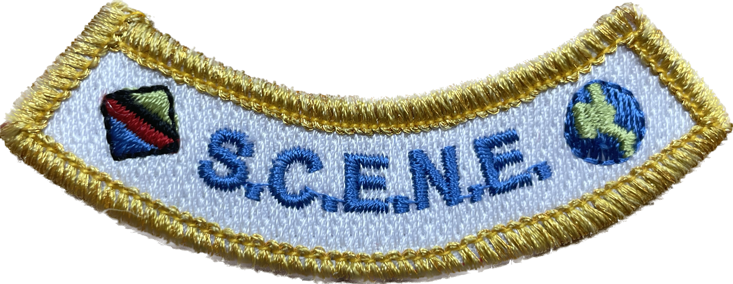


Certifications & Awards
Club Cayo Hueso (Keys Adventure)
Castaway Club (Out Island)
Citizen Science Award (Marine Eco Expedition)
S.C.E.N.E. Award
Duty to God Award
Kayaking BSA Award
Snorkel BSA Award
Stand Up Paddleboard BSA Award

Slide 14
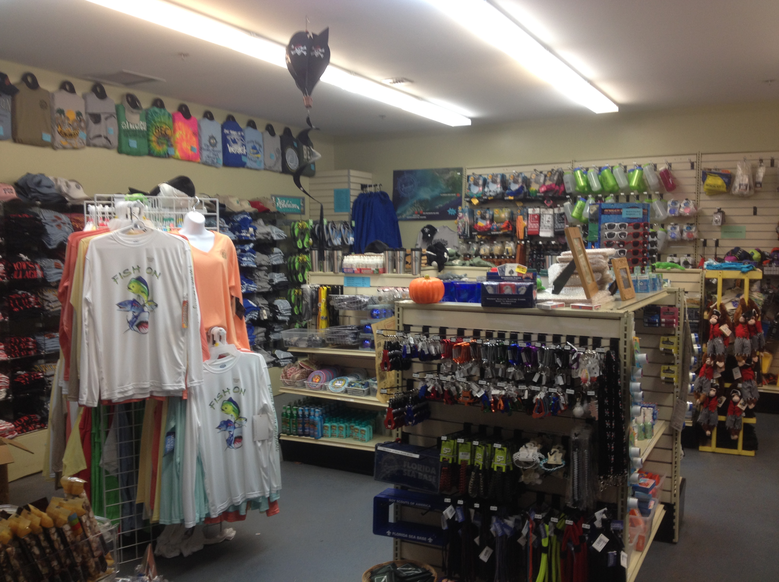
Ship Store
In our wonderful Ship Store you and
your crew can find just about anything!
Fun T-Shirts, water bottles, hammocks, key chains, belts and a whole lot more.
Can’t Pack it on the airplane? No Problem!
We have plenty of sunscreen, bug spray and any other camping necessities you may need.
Visit the Ship Store website at www.store.bsaseabase.org

Slide 15


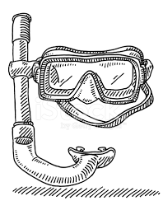
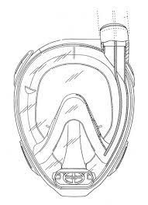

Frequently Asked Questions
What mask and snorkel should I bring? You can purchase a mask and snorkel from the Sea Base Ship Store or go to your local dive shop, or even department stores. Anything that is comfortable will work. We recommend trying out your mask and snorkel in the pool before you travel to Sea Base to be sure the fit is good. Full face masks are not permitted.
Should I bring fishing gear? Sea Base will provide all the fishing gear you need.
For camping on Big Munson Island, will there be power on the Island to plug in my CPAP machine? No, Big Munson Island is a primitive island without power. We suggest packing plenty of battery backups for your CPAP machine or other necessary electronic devices.
Should I bring a water bottle? All participants should bring a wide-mouth Nalgene-style reusable water bottle.
What if I cannot pass the BSA Swim Test prior to arrival? You will not be permitted to participate or stay at Sea Base.
What if I cannot complete the Sea Base Swim Review upon arrival? You will not be permitted to participate or stay at Sea Base.
What if I arrive without a signed medical? All medical documentation must be taken care of in advance and signed by a physician. You will not be permitted to participate or stay at Sea Base.
What if I arrive at Sea Base and exceed the maximum weight limit of 295 lbs.? You will not be permitted to participate and will be sent home at your own expense.

Slide 16
National High Adventure Sea Base
Boy Scouts of America
Brinton Environmental Center Adventures
Thank you!
Keys Adventure
Out Island Adventure
Fishing Adventure
Marine Eco Expedition

